Slide 1
Energy Transition:
Challenges in RE Capacity Addition
&
New Technologies
16th Nov. 2018

Slide 2
Outline
Power Scenario
Renewable capacity Addition
  Status
  Challenges & Mitigation
Way Forward

Slide 3
National Power Scenario
Total Installed Capacity ~ 347 GW
Thermal:
222 GW
Hydro:
46GW
Renewable:
73 GW
Nuclear:
7 GW
Type Wise Capacity
Notes:
29 states + 7 UTs
Total No. of Consumers in India 200 million
Population of India 1250 million

Slide 4


Changes in Resources
 | 2008 | 2014 | 2018
Fossil Fuel (Coal, Gas, Diesel) | 92 GW (64%) | 169 GW (68%) | 223 GW (64%)
Hydro | 33 GW (22%) | 41 GW (16%) | 46 GW (13%)
Renewable Energy | 11 GW (7.7%) | 32 GW (13%) | 73 GW (21%)
Wind |  | 21.1 GW | 35.5 GW
Solar |  | 2.6 GW | 23.1 GW
Others |  | 7.9 GW | 14 GW
175 GW RE by 2022
100 GW
Solar
60 GW
Wind
10 GW
Biomass
5 GW Small Hydro

Slide 5
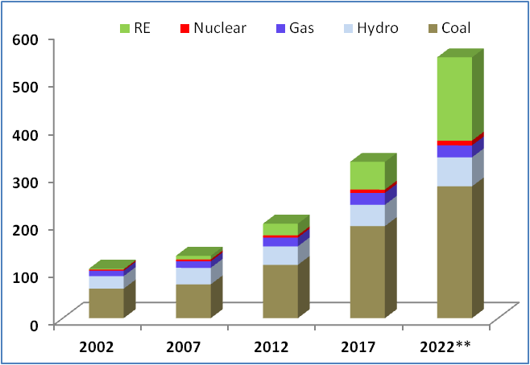
Future Scenario
Drivers
Demand Growth ( Per capita consumption -1/3rd of world average)
About 10 fold increase in last one decade in RE capacity penetration
Abundant RE Potential in Country
Source- CEA monthly report & draft national electricity plan - transmission

Slide 6
Initiatives towards RE grid integration
Green Energy Corridors (GEC) Scheme comprising Transmission & Control Infrastructure
  GEC- ISTS is under implementation by POWERGRID
  Intra State Transmission system by respective state utilities
Green Energy Corridors-II, Transmission for Ultra Mega Solar Power parks
  Transmission for 7 nos. Solar Parks is under various stages of implementation by POWERGRID. Transmission commissioned for Pavagada, NP Kunta & Rewa UMSPP
  Other Solar Parks by State Utilities
  Establishment of Renewable Energy Management centers at 11 locations in RE resource rich states
    Commissioning progressively from Mar’19
6

Slide 7
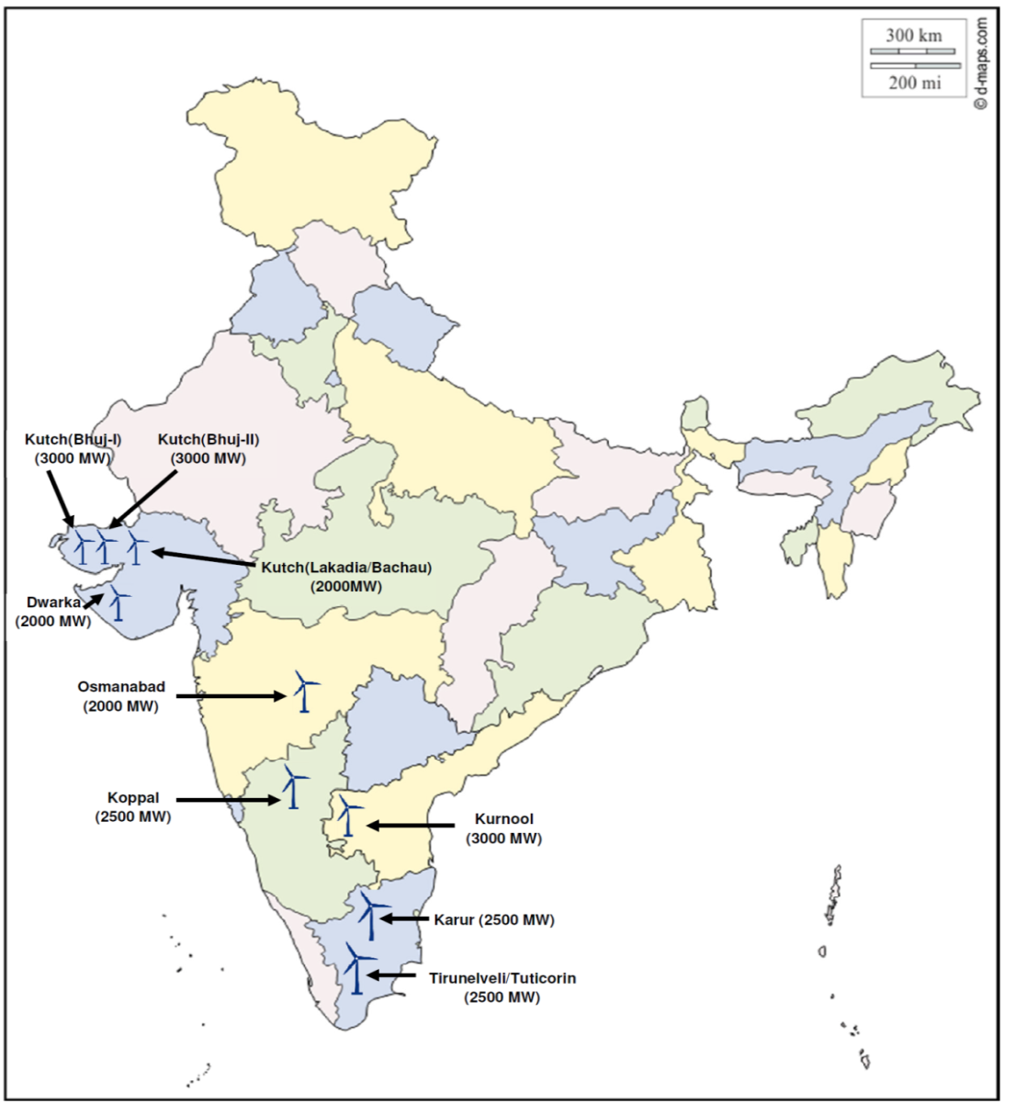
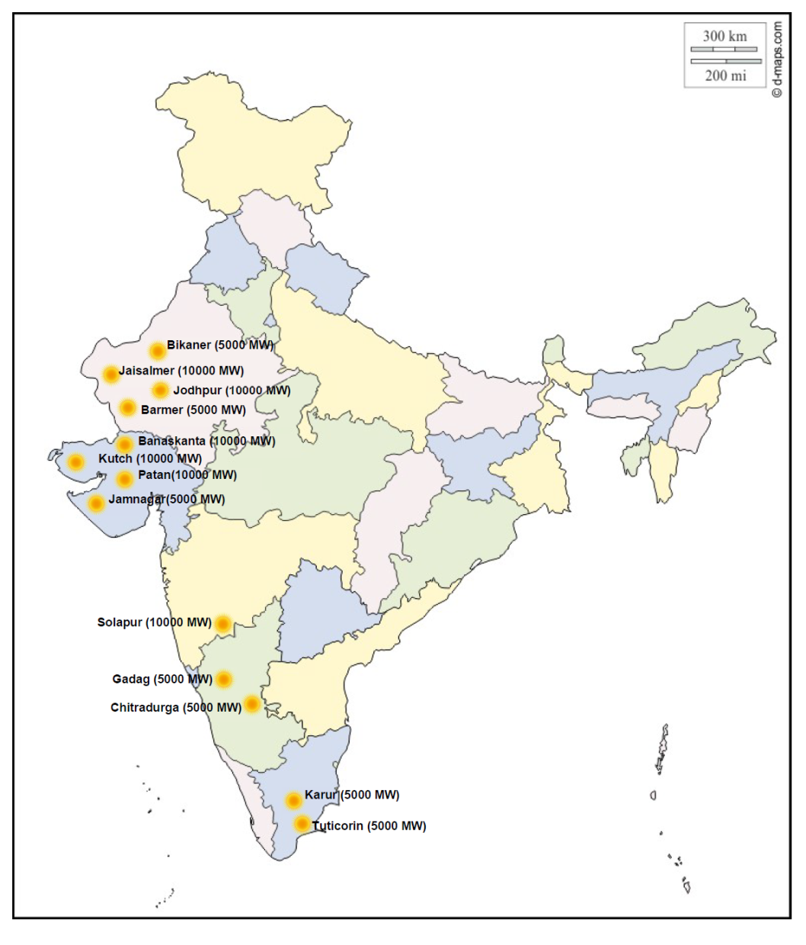
GEC-III : Renewable Energy Zones
  Green Energy Corridors-III: Transmission Plan for Renewable Energy Zones (66.5 GW)
    50 GW Solar + 16.5 GW Wind: Under various stages of approval
Wind (16.5 GW)
Solar (50 GW)
Transmission for Wind & Solar Energy Zones (66.5 GW) Evolved

Slide 8
RE Generation Status
Target: 175 GW , Installed: 74 GW, Balance: 101 GW
19.3GW RE capacity is under various stages of implementation

Slide 9
RE Integration Status
Transmission scheme identified for additional 72.5GW REZs (Solar 50GW, Wind: 22.5GW)
  Wind : 6GW scheme under implementation
  For balance capacity of 66.5 GW [Wind : 16.5GW & Solar : 50GW], Scheme already identified
    Transmission Scheme identified for prioritized REZ (12 GW)
    Scheme agreed in Regional Standing Committee on Transmission
    To be taken up in
      Regional Power Committees, NCT & ECT for further approval and finalize implementation modalities
Notes:
6 GW: Bhuj & Thirunelveli area Augmentation

Slide 10
Renewable Grid Integration - Issues
Grid Operational
Grid Planning
Intermittent & Variable
Partial Predictable
Managing Load Generation balance
Net Load ramp
Voltage Ride through & Reactive Power Management
Observability of Distributed Energy Resources
Low Gestation period of RE Generation (Wind / Solar)
Strength of Grid (Fault Level) at the Point of RE interconnection
Quantum of RE generation- Phased development
RE power destination
Reactive Power Management
    constituents concerns increasing transmission charges.

Slide 11
Mitigating measures towards greater RE penetration
Enlargement of balancing area through strong grid interconnection
Establishment of Robust Transmission Path – RE Zone based developments & complex based generation bidding
Transmission to lead generation
RE Forecasting
Innovative funding mechanism to rationalise tr. charges
Flexible Resources (Supply & Demand ) Management
Strict compliance to regulations/Standards (LVRT/Harmonics/DC injection/Active Power Control etc.) – Ancillary service support
Real Time Monitoring (Communication & Data telemetry), Visualization & Forecasting
Energy Storage, Dynamic Reactive support
Capacity Building

Slide 12
Way forward
Strong grid interconnection
Flexibility of Resources (Supply & Demand )
Real Time Monitoring (Data telemetry)
Capacity Building

Slide 13
Thank You
rajeshkumar@powergridindia.com

Slide 14
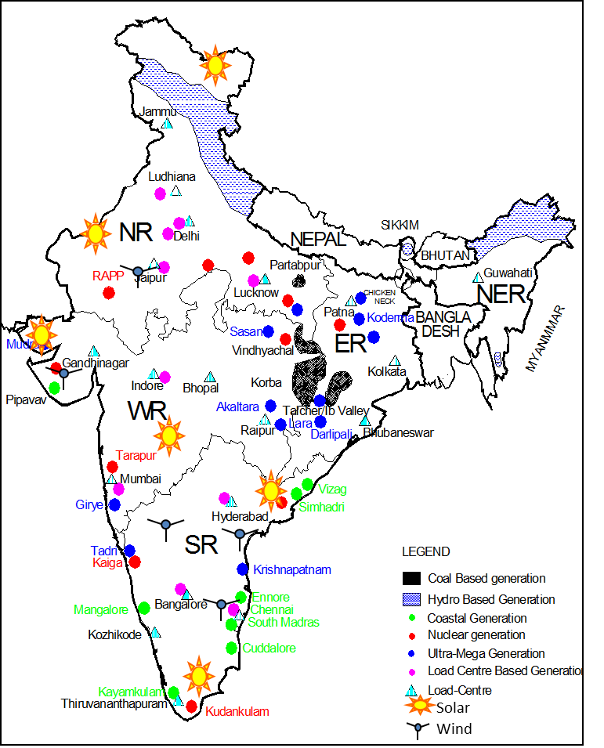
Generation Potential
Energy resources (coal, RES etc.) unevenly distributed
Hydro – In North Eastern & Northern Himalayan region
Coal – In Central India
  Chhattisgarh , Orissa , Jharkhand, Madhya Pradesh
Coastal based
  Andhra Pradesh, Tamil Nadu, Gujarat
Renewable Energy – Solar & Wind Across the country
  Major Potential Areas : Tamil Nadu, Andhra Pradesh, Karnataka, M.P, Rajasthan, Maharashtra, Gujarat
Notes:
Global electricity sector investment is anticipated to reach USD 10 trillion by 2030. It is estimated that investments in transmission and distribution sector would be as much as that in the generation sector during the period.
In India the average investment in T&D in India during the Tenth Plan was about 32% of investment in generation
The GoI intends to increase installed power generation capacity by 87,663 MW by 2012, it must also facilitate an expansion of the transmission network and inter-regional capacity to transmit power
With the strengthening of inter-regional connections by 2012, the inter-regional capacity is predicted to grow from 14,100 MW to 37,150 MW
Investment of Rs 1,400 billion (approx. USD 34 billion) envisaged in transmission sector in XI plan
To expedite Generation addition of 100,000 MW, GOI is promoting UMPP each of 4000MW capacity to meet its mission of power for all by 2012
POWERGRID has been requested to prepare feasibility reports / detailed project reports in respect of its anticipated role in the construction of the transmission system associated with Ultra mega Power Projects

Slide 15
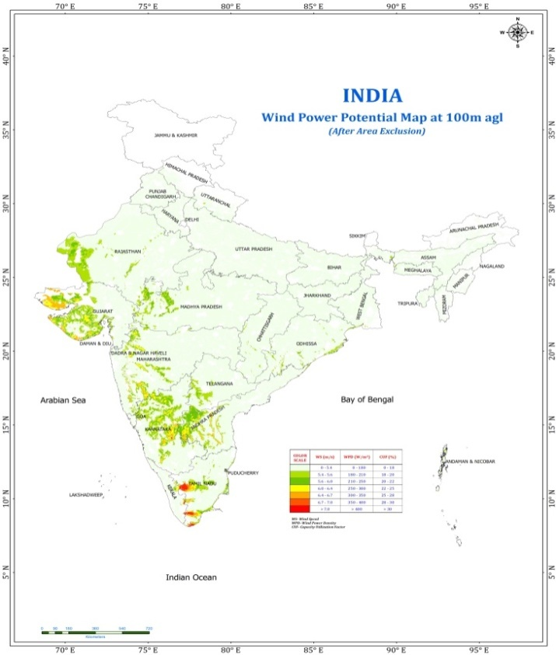
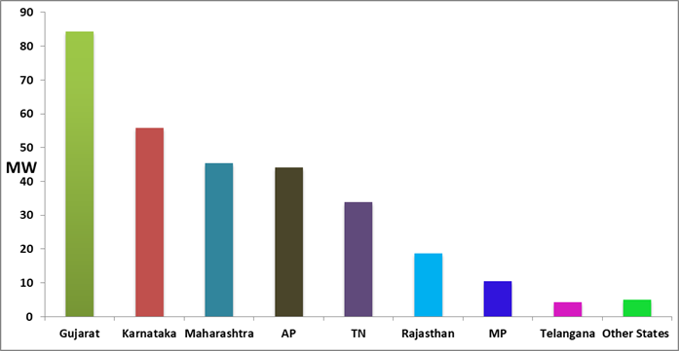
Wind Potential in India
Wind potential: 302GW at 100 meter hub height
97% wind potential comprises in six wind resources rich states viz. Gujarat, AP, Tamil Nadu, Maharashtra, Karnataka & Rajasthan

Slide 16
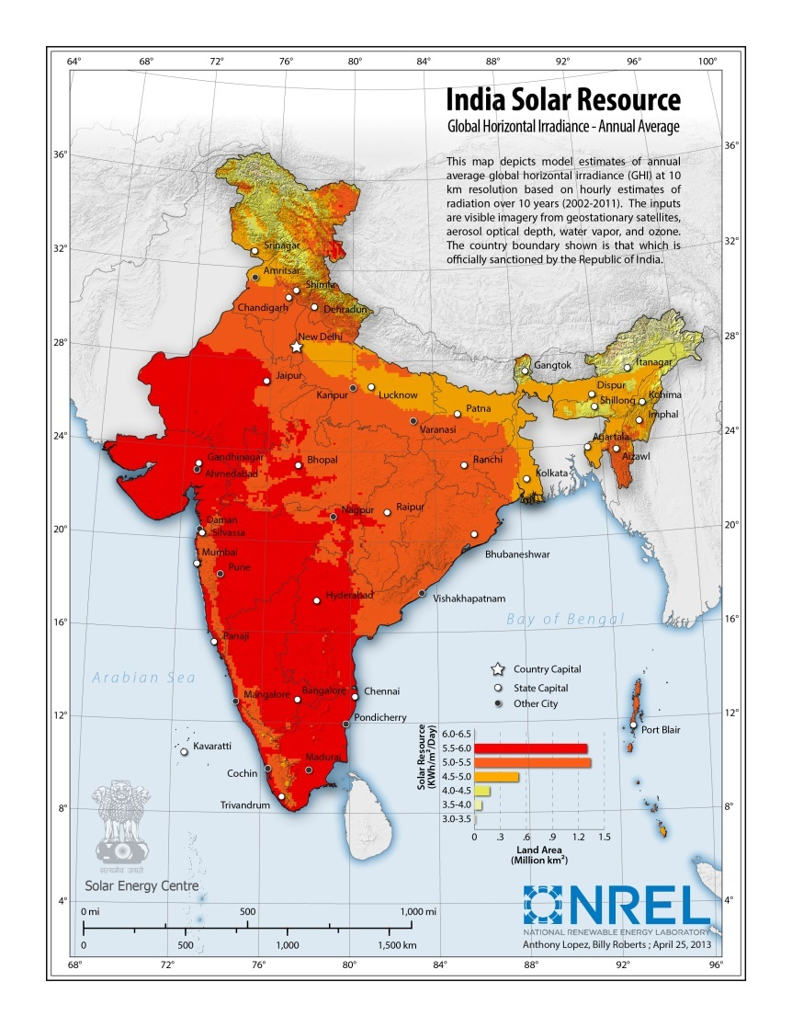
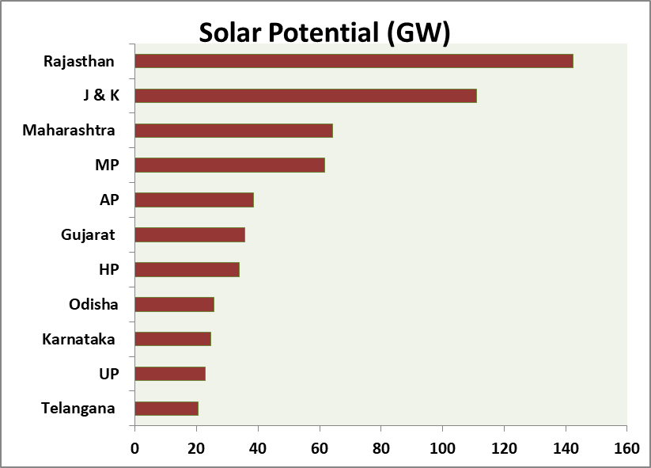
Solar Potential in India
Solar potential : 749GW

Slide 17
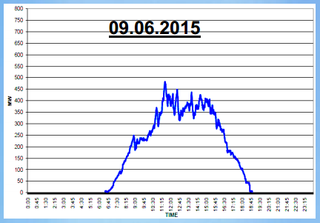
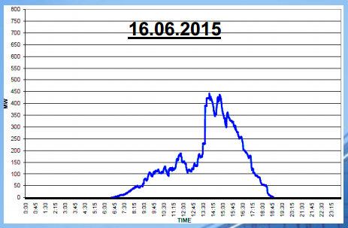
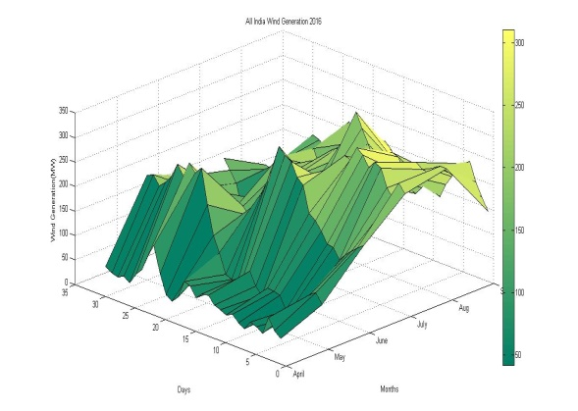
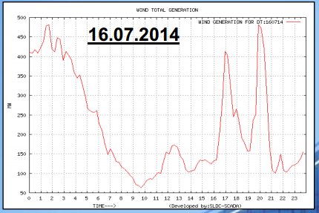
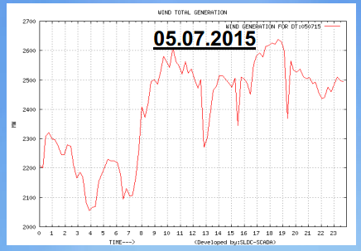
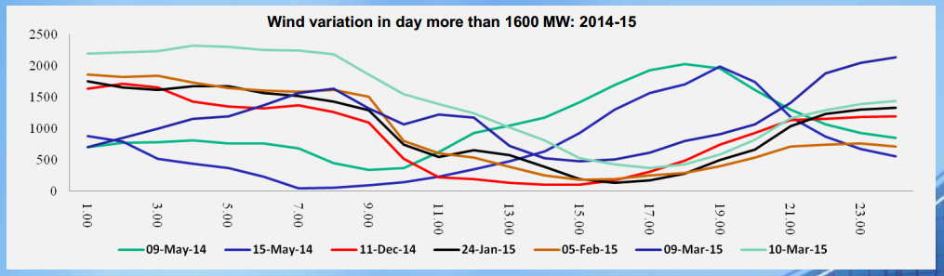
Renewable Integration - Challenges
Intermittency & Variability
Short gestation period
Load- Generation imbalance
All India Wind Gen. Apr-Sep’16
Date
Months

Slide 18
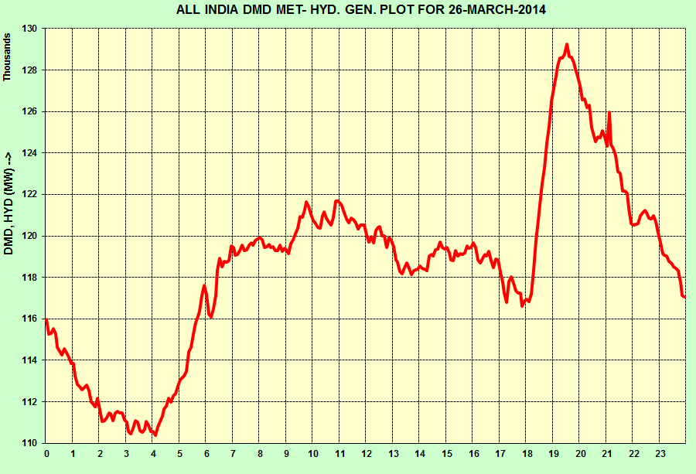
Typical Load Curve
18
Evening Peak @ 200 MW/min
for 40 minutes
Morning Peak @ 140 MW/min
for 40 minutes
Notes:
18

Slide 19
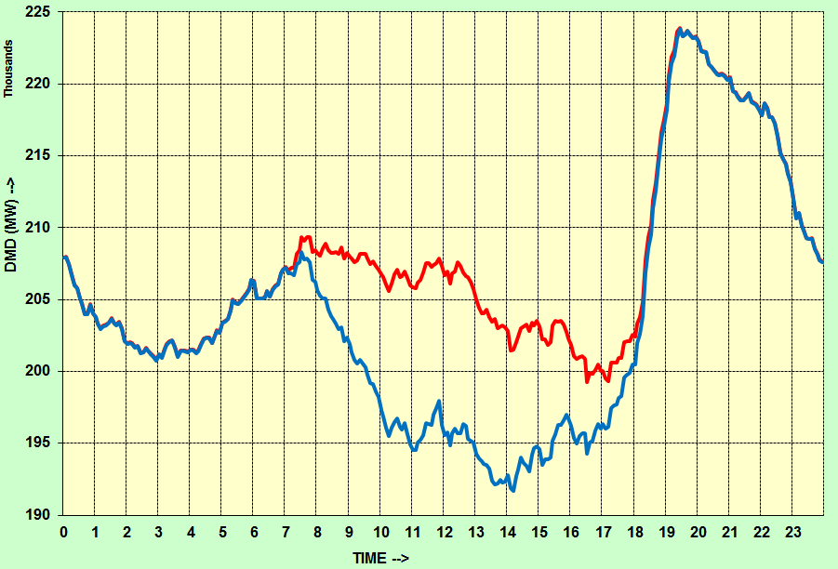
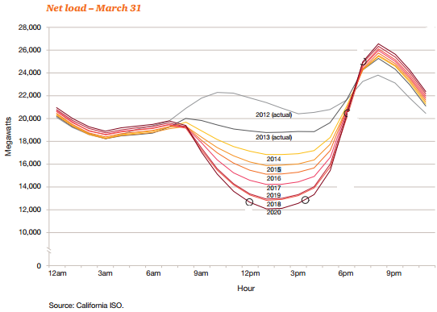
Net Load Curve
Head:
Evening Peak
Actual Demand
Neck:
Steep ramping
Net Load
Belly:
Decrease in net load
Source: NLDC SCADA data, CAGR assumed: 8%

Slide 20
Typical Wind Generation Forecast
Source- GETCO

Slide 21
Mitigation
Maintaining Real Time Load Generation Balance, Stability & Security of the network
Renewable
Fluctuations
System
Flexibility
Variability
&
Uncertainty
Generation,
Transmission
Distribution
Consumer
National Grid Strengthening
Forecasting
Ancillary Services / market

Slide 22
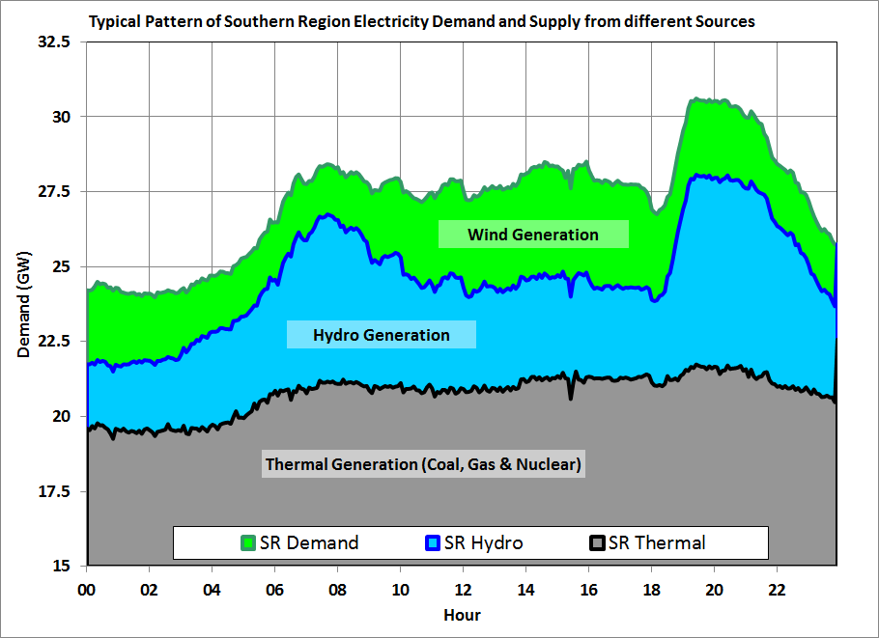

Slide 23
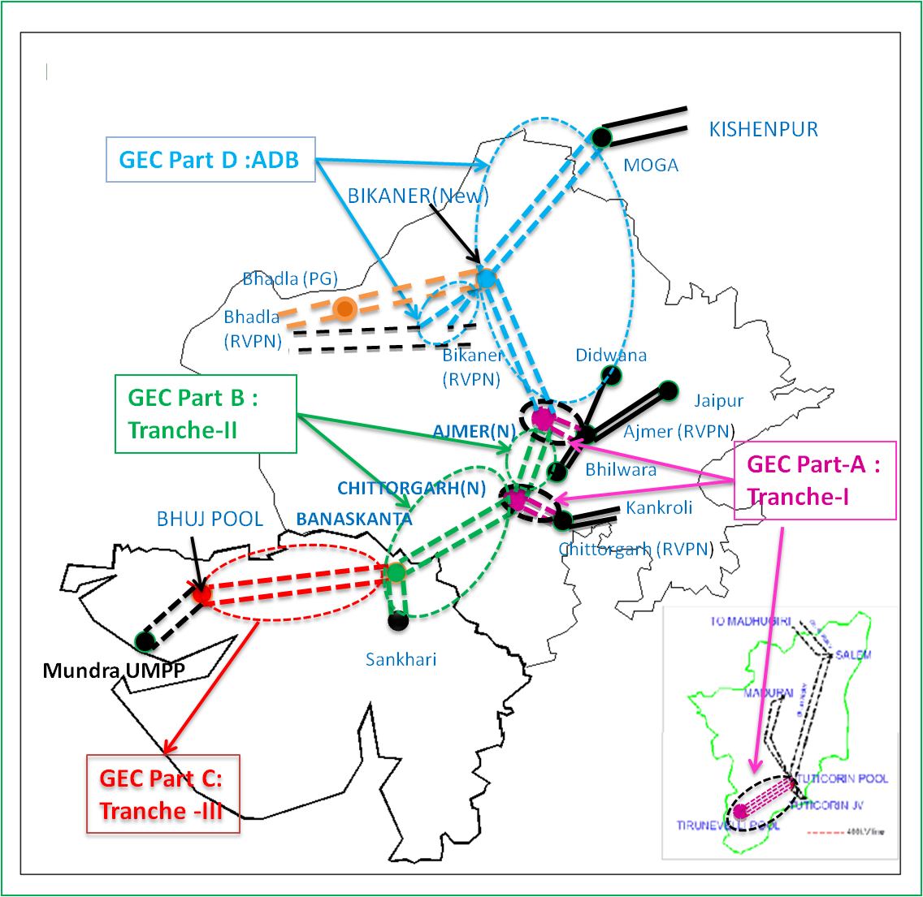
Green Energy Corridors
  Intra & Inter State Transmission strengthening:
    For integration of Renewable energy sources with the grid
    Integration of UMSPP
  Dynamic compensation (SVC & STATCOM):
    To maintain grid parameters
  Renewable Energy Management Centres (REMC):
    For RE forecasting, Scheduling & real time monitoring
GEC – Commissioned/
Under Implementation

Slide 24
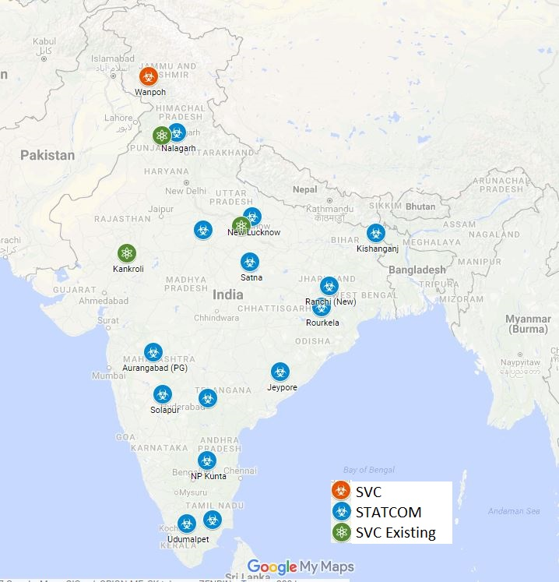
Dynamic Compensation
Facilitating Renewable Integration
Maintaining system parameters
14 No. of Hybrid STATCOMs
4 No. of SVCs

Slide 25
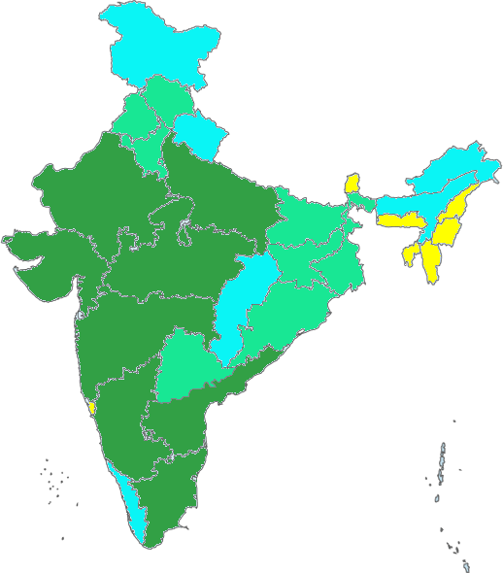
Renewable Energy Management center
11 no. of REMC : 7 States + 3 Regions + 1 National level
NLDC
NRLDC
WRLDC
MP
Guj
Raj
Mah
SRLDC
Kar
TN
AP
NLDC
NRLDC
Rajasthan
Gujarat
MP
Maharashtra
WRLDC
AP
Forecasting of RE generation
Real time tracking of RE generation from RE sources
Scheduling solutions
Karnataka
SRLDC
TN

Slide 26
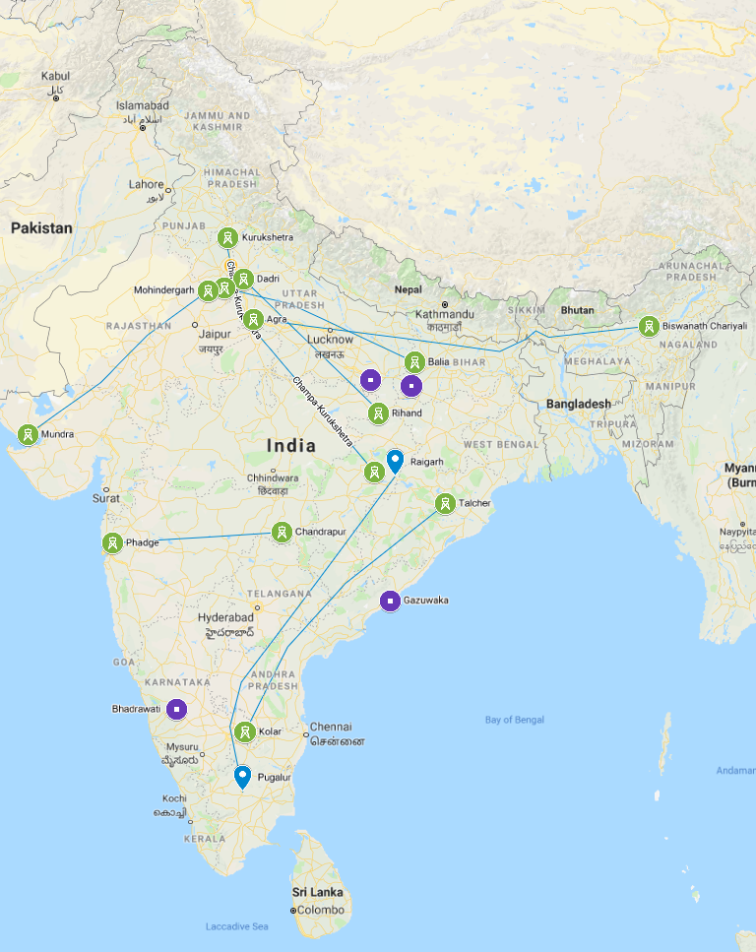
HVDC System
-Bipole
-Back-to-Back
U/C
Note: Line route Indicative & Map Not To the Scale

Slide 27
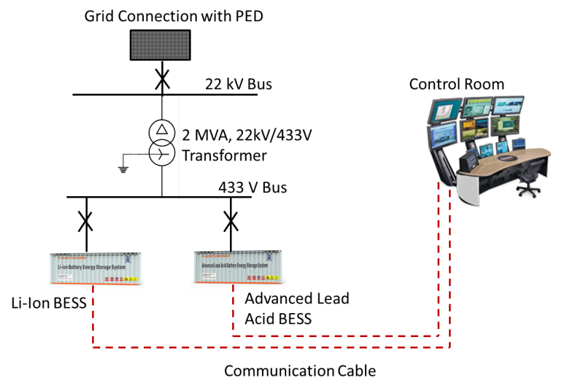
BESS - Architecture

